Slide 1

Simplified Sckhaedgeuler (SS)
A Software Design Project by:
Alex Thayn, Leedan Johnson, Jackson Porter

Slide 2
What is the Simplified Sckhaedgeuler?
The Simplified Sckhaedgeuler provides an all-around solution to room scheduling. From students to building managers our software adapts to fit each user’s needs:
Experience a consistent and easy to use web interface.
Finding a room for last minute study sessions is no longer a problem.
Searching for the “right” room has been simplified, users can filter search results to find the room of their dreams.
Academics take priority! No more getting kicked out of your reservation.
Managers will maintain control of each building and receive up-to-date feedback about room issues from users.
View and report issues with a room instantly.
Never forget a meeting again! Sign up for notifications to receive reminders about your upcoming reservations and events to which you’ve been invited.
Our software helps all overcome the challenges of traditional room management, allowing the process to be effortless and enjoyable.
Notes:
The Simplified Sckhaedgeuler provides an all-around solution to room scheduling. From students to building managers our software adapts to fit each user’s needs:
Experience a consistent and easy to use web interface.
Finding a room for last minute study sessions is no longer a problem.
Searching for the “right” room has been simplified, users can filter search results to find the room of their dreams.
Academics take priority! No more getting kicked out of your reservation.
Managers will maintain control of each building and receive up-to-date feedback about room issues from users.
View and report issues with a room instantly.
Never forget a meeting again! Sign up for notifications to receive reminders about your upcoming reservations and events to which you’ve been invited.

Slide 3
1: Contextual Inquiry
To begin our project, we first had to formally identify the system we were trying to replace. In this case, the room scheduling system.
After we had this rough idea of our project’s scope, it was time to come up with a name.
The Simplified Sckhaedgeuler may look like a contradiction. To us, it represents taking something extremely complex and nuanced, and presenting it to the user in a way that is simple, and easy to understand.
Notes:
To begin our project, we first had to formally identify the system we were trying to replace. In this case, the room scheduling system.
After we had this rough idea of our project’s scope, it was time to come up with a name.
The Simplified Sckhaedgeuler may look like a contradiction. To us, it represents taking something extremely complex and nuanced, and presenting it to the user in a way that is simple, and easy to understand.

Slide 4
1: Contextual Inquiry
In order to justify our project, we found several aspects of the current system we believed needed improvement. We narrowed these down to 5 principal issues.
Accessibility
Immediacy
Time Required
Consistency
Bias
Notes:
In order to justify our project, we found several aspects of the current system we believed needed improvement. We narrowed these down to 4 principal issues.
Accessibility (where to find them, who do I talk to?)
Immediacy (other responsibilities, timeing)
Time Required
Consistency (across campus, and views)
Bias

Slide 5
1: Contextual Inquiry
We then attempted to identify the types of individuals who use the scheduling system. We were left with the following:
Room Schedulers
Students
Faculty
Notes:
We then attempted to identify the types of individuals who use the scheduling system. We were left with the following:
Room Schedulers
Students
Faculty

Slide 6
1: Contextual Inquiry
From this list of user types, we planned and made appointments to meet with individuals from each of these categories.
Room Schedulers
Margie Anderson
Michael Lewellen
Faculty
Heber Allen
Students
Ty Bayn
Nathan Hebert
Ammon Riley
Notes:
From this list of user types, we planned and made appointments to meet with individuals from each of these categories.
Room Schedulers
Margie Anderson
Michael Lewellen
Faculty
Heber Allen
Students
Ty Bayn
Nathan Hebert
Ammon Riley

Slide 7
1: Contextual Inquiry
Throughout our interviews and workshops, we recorded all that was said, and took many notes. From this we were able to complete our User-Centered Business Canvas.
The notes and data gathered from these meetings also were used extensively in the construction of our Work-Activity Affinity Diagram
Notes:
Throughout our interviews and workshops, we recorded all that was said, and took many notes. From this we were able to complete our User-Centered Business Canvas.
The notes and data gathered from these meetings also were used extensively in the construction of our Work-Activity Affinity Diagram

Slide 8
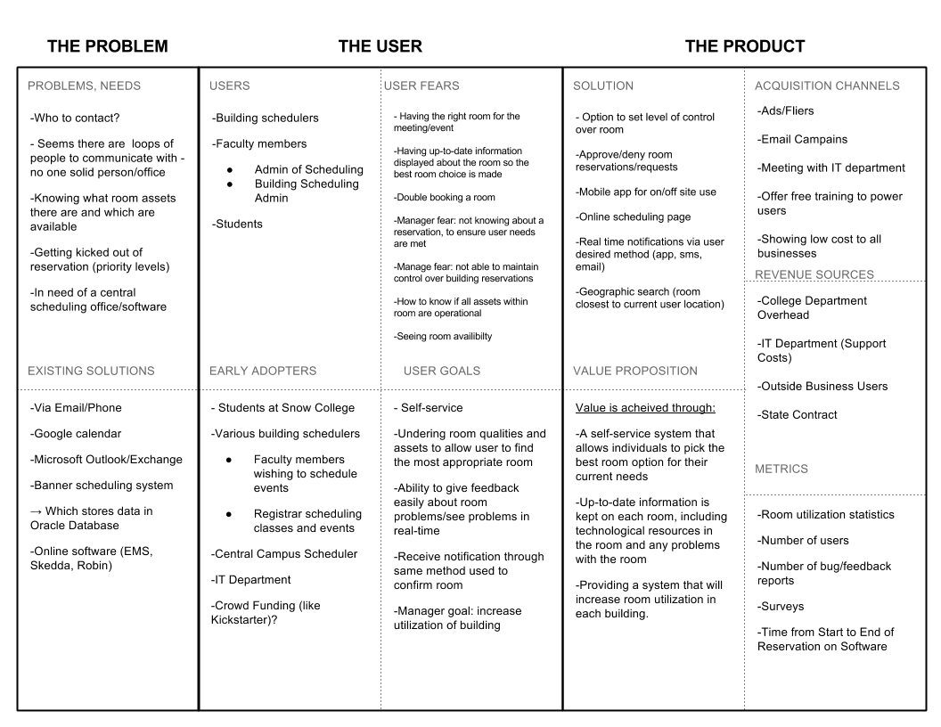
2: Contextual Inquiry & Analysis
The User-Centered Business Canvas
Notes:
The User-Centered Business Canvas
User Needs
Existing solutions
User goals
User Fears
Our value

Slide 9
2: Contextual Inquiry & Analysis
LESSON LEARNED
Over the course of this activity, one of the most difficult, and most valuable things we had to do was put aside our preconceived ideas for the solution, and focus on what the users had told us was important to them.
Notes:
LESSON LEARNED
Over the course of this activity, one of the most difficult, and most valuable things we had to do was put aside our preconceived ideas for the solution, and focus on what the users had told us was important to them.

Slide 10
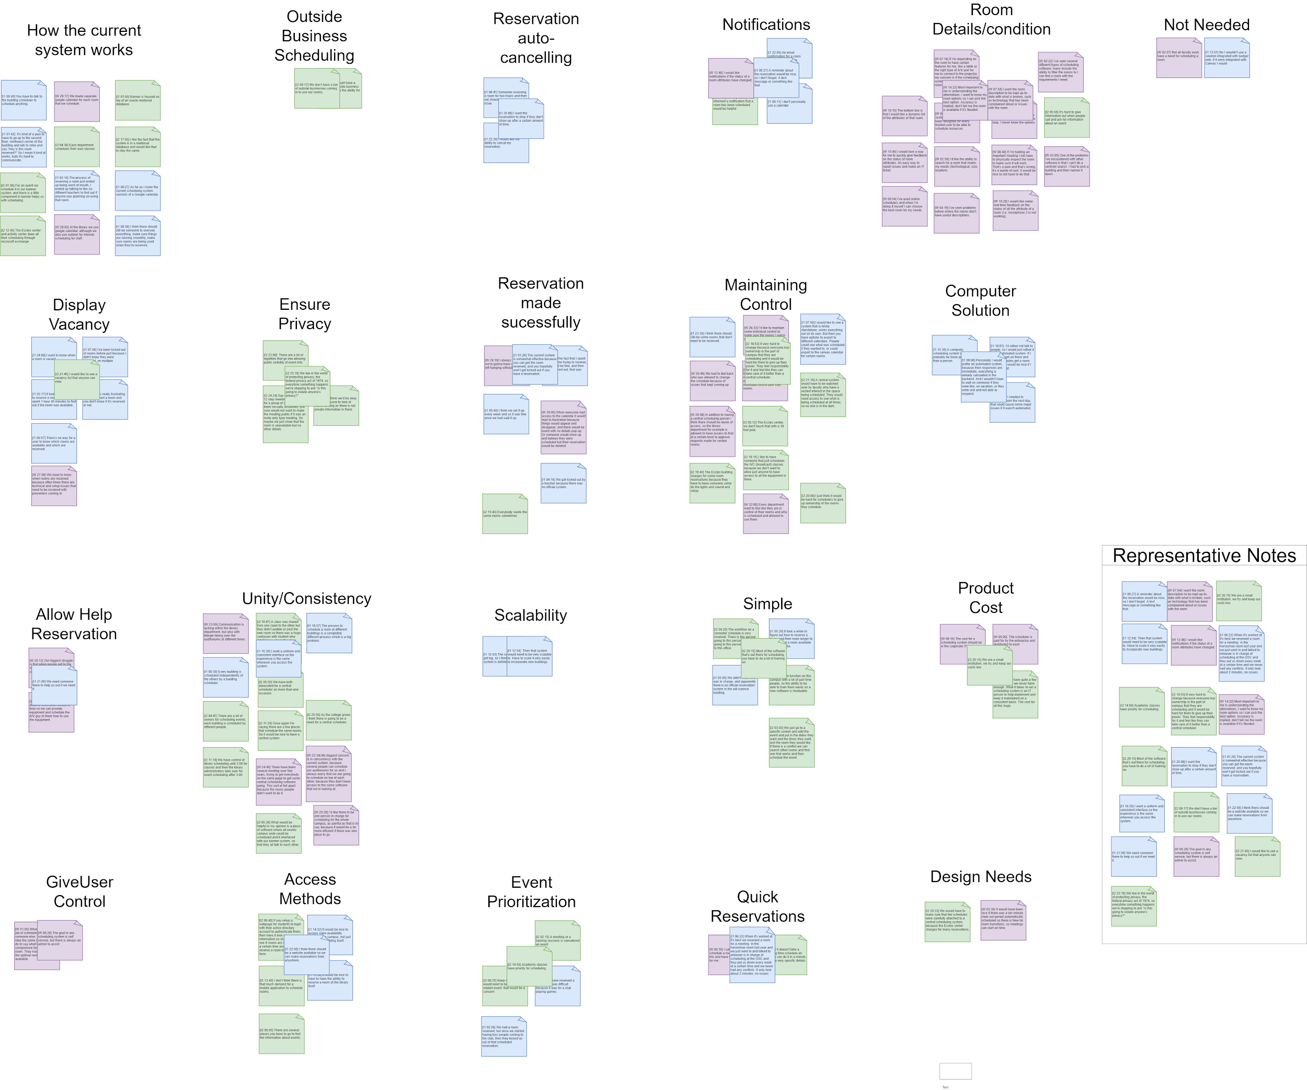
2: Contextual Inquiry & Analysis
The construction of our WAAD (Work-Activity Affinity Diagram) was no small effort, but the insight it offered was invaluable.
Notes:
WAAD

Slide 11
2: Contextual Inquiry & Analysis
After having met with these system users, we defined each of the work roles in the existing system.
User Roles
Registrar
Student
Faculty
Building/Dept Manager
Outside Entities
Machine Roles
Database
Notes:
After having met with these system users, we defined each of the work roles in the existing system.
User Roles
Registrar
Student
Faculty
Building/Dept Manager
Outside Entities
Machine Roles
Database

Slide 12
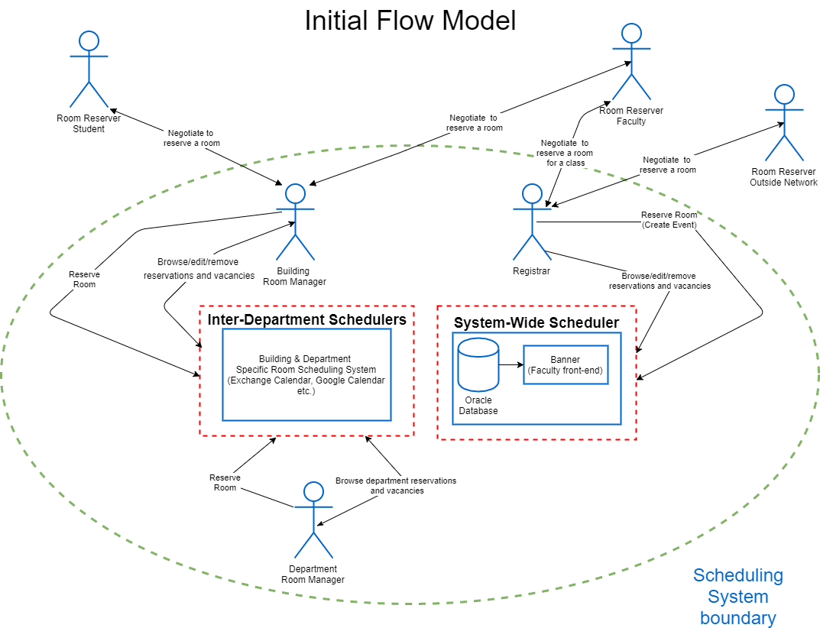
2: Contextual Inquiry & Analysis
Using these work roles, we created Flow Models to illustrate the existing system, and to show how our solution would fit in and change the existing system.
Notes:
Initial Flow Model
Using these work roles, we created Flow Models to illustrate the existing system, and to show how our solution would fit in and change the existing system.
(The proposed flow model will be shown later)

Slide 13
3: Design Requirements
Scope of Our Project
Ability to schedule not only events, but also classes
Need for a central scheduler
Reduce responsibility of building manager
No outside business support
Narrowed down our personas
Notes:
Explain how we tailored the scope of our project.
We decided to that we wanted to provide support for creating room reservations for events such as club meetings, or study group sessions, but we also wanted to provide support for the central scheduler who would be in charge of scheduling classes.
The need for a central scheduling system came up quite a bit during our inquiry interviews. We decided to build an entire persona around the central scheduler, and our system was shifted to incorporate this person. The central scheduler would be the system administrator and oversee all reservations with the help of our software.
When we chose to add a central scheduler, we decided the responsibilities of the building manager would be diminished. In the beginning the building manager would still be able to view and change reservations within their building if needed, but slowly over time the hope is that control of the system would slowly shift and become managed solely by the central scheduler.
We decided that outside business reservations were rare enough that we did not feel the need to provide a way for them to access our software.

Slide 14
3: Design Requirements
Personas
Student: Paul Jordan
Building Manager: Mary Smith
System Administrator: Jonathan Steel
Notes:
We narrowed down our project to include three main personas. We felt to accurately represent our software in its entirety, these three personas were required.

Slide 15
3: Design Requirements
Requirements were extracted from the WAAD
Notifications
Low-cost
Room Details/Leave room feeback
Scalability
Recurring reservations/Fast reservations
Prioritization
Manager Access
Simplicity
Unity/Consistency
No Outside Business support
Web Access
Public Vacancy list
Optional Hidden Details
Notes:
These are the requirements that we extracted from our Work activity affinity diagram. One requirement was chosen as a representative requirement from each of the categories we identified in the WAAD

Slide 16
3: Design Requirements
Models
Hierarchical Task Inventory
Flow Model
Social Diagram
Notes:
To help us visualize our system better we created a few different models and diagrams.
The first diagram is the hierarchical task inventory. We created one for each of our three personas. It helped us determine all the tasks each persona might need to be able to perform and in what order.
The flow model we created helped us visualize the interaction flow between each user that might be involved in our system.
The social diagram was created to help us visualize the concerns of each user and how all the users interact with each other. We were also able to identify barriers to usage.

Slide 17
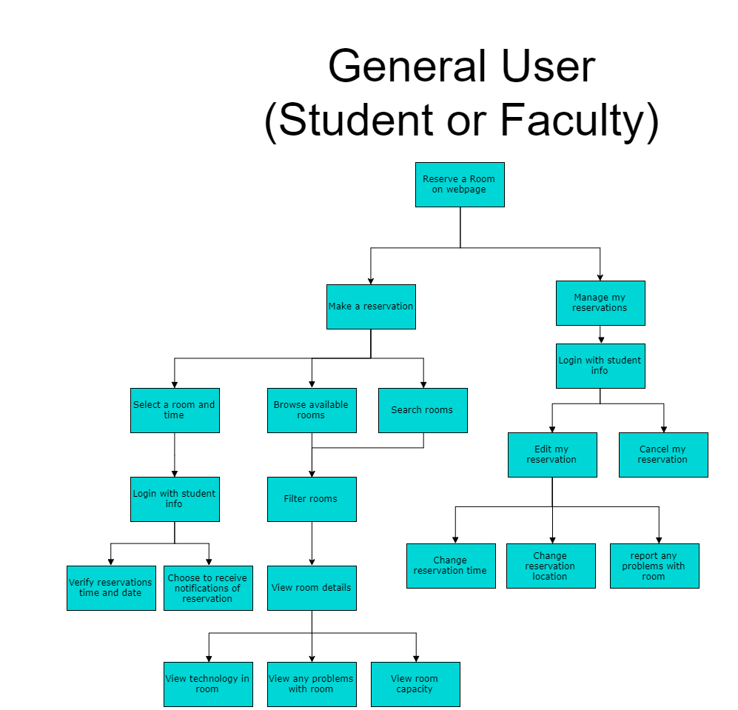
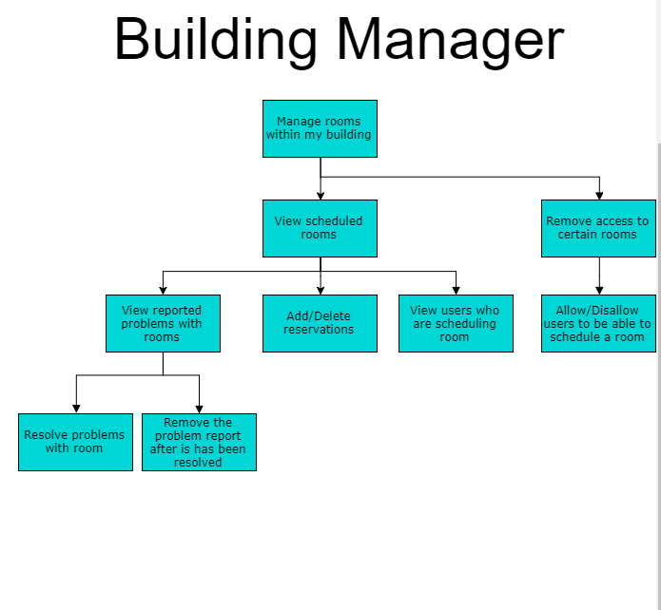
3: Design Requirements
Notes:
These are the Hierarchical task inventory models. These models helped us map out all the possible tasks a user might want to perform.

Slide 18
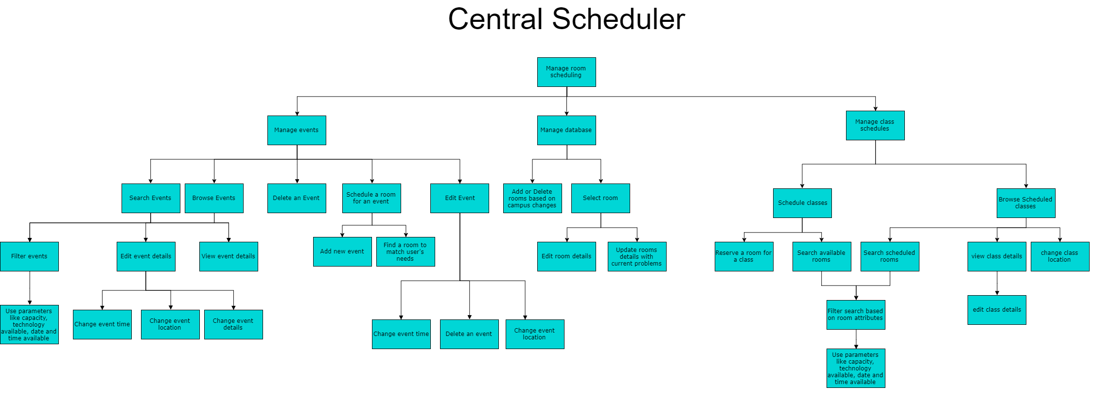
3: Design Requirements

Slide 19
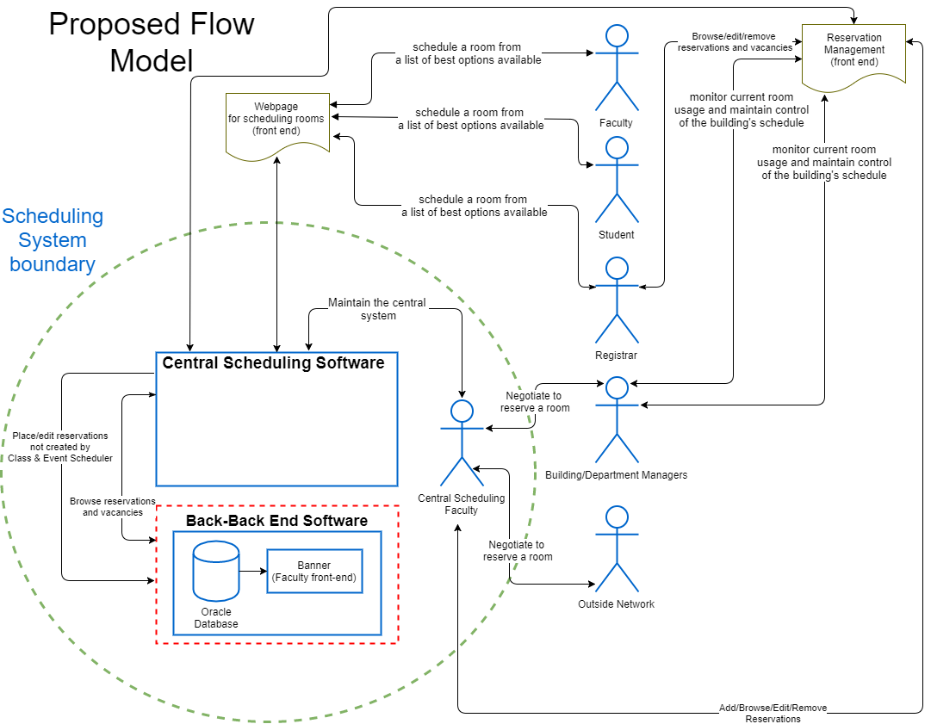
3: Design Requirements
Notes:
This is the proposed flow model. We showed the initial flow model earlier, which represents the system as it is now. This is how we envision the flow within our proposed system

Slide 20
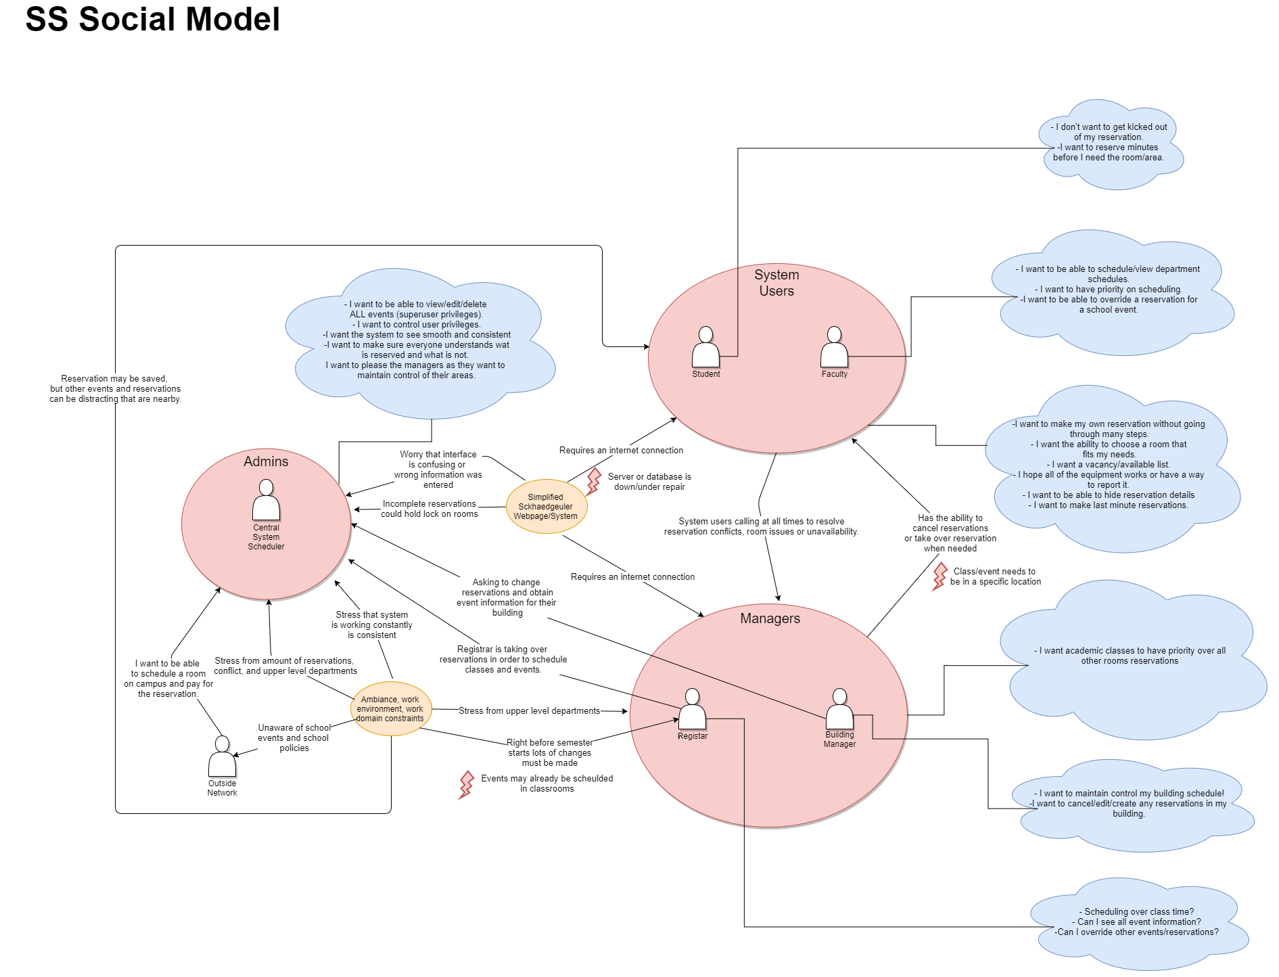
3: Design Requirements
Notes:
The social diagram was created to help us visualize the concerns of each user and how all the users interact with each other. We were also able to identify barriers to usage, the barriers indicated any problems a user might run into while using our system.

Slide 21
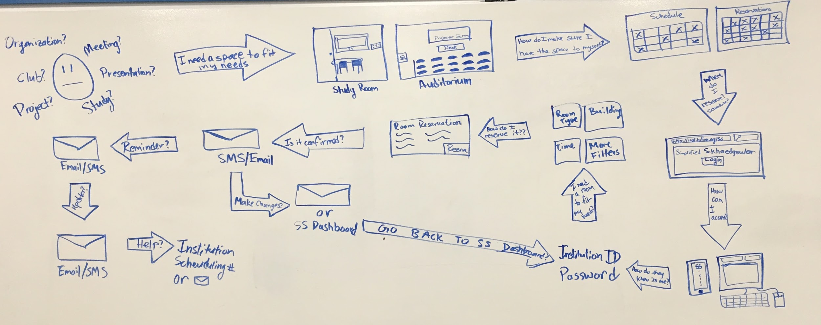
4: Design
Ideation and sketching
Notes:
We began the design phase with ideation and sketching. We met as a group and threw all our ideas up on the whiteboards. At this point all ideas were acceptable, no matter how far-out or strange they were.

Slide 22
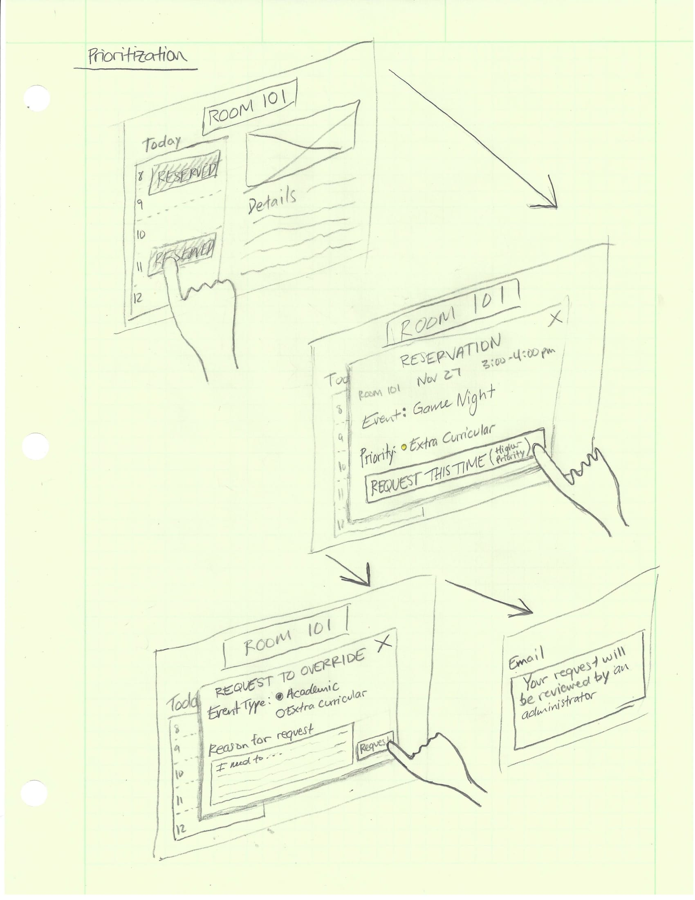
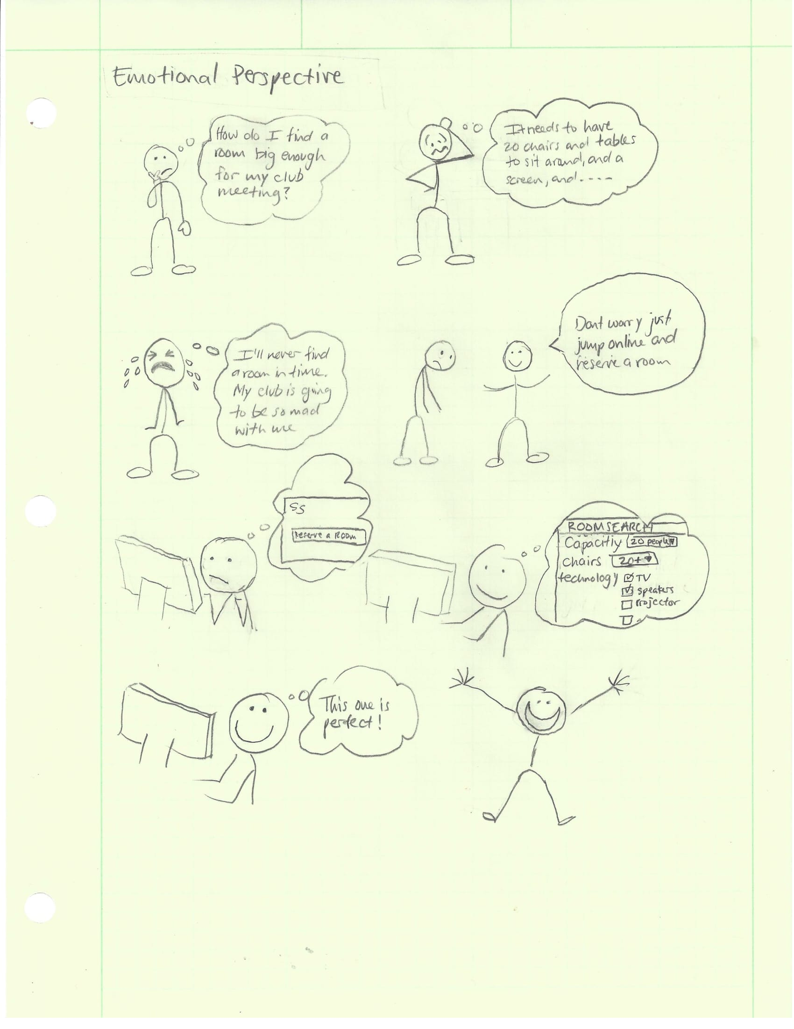
4: Design
Notes:
We then began sketching, this helped us visualize and start narrowing down our scope.

Slide 23
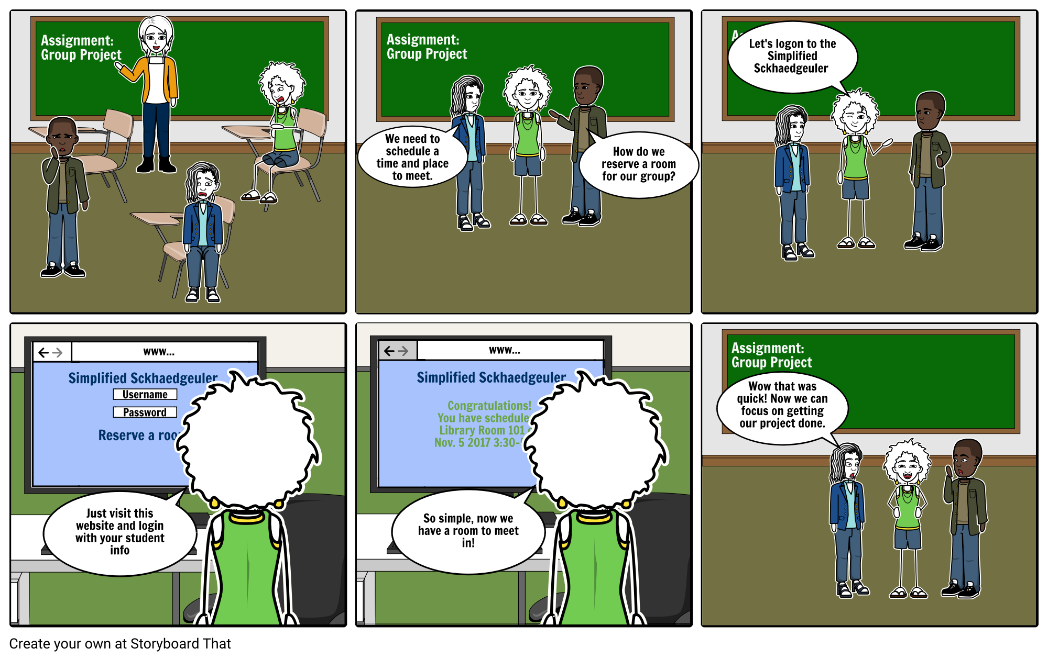
4: Design
Notes:
We also created some storyboards to help us gain insight into how the users might be using our software.

Slide 24
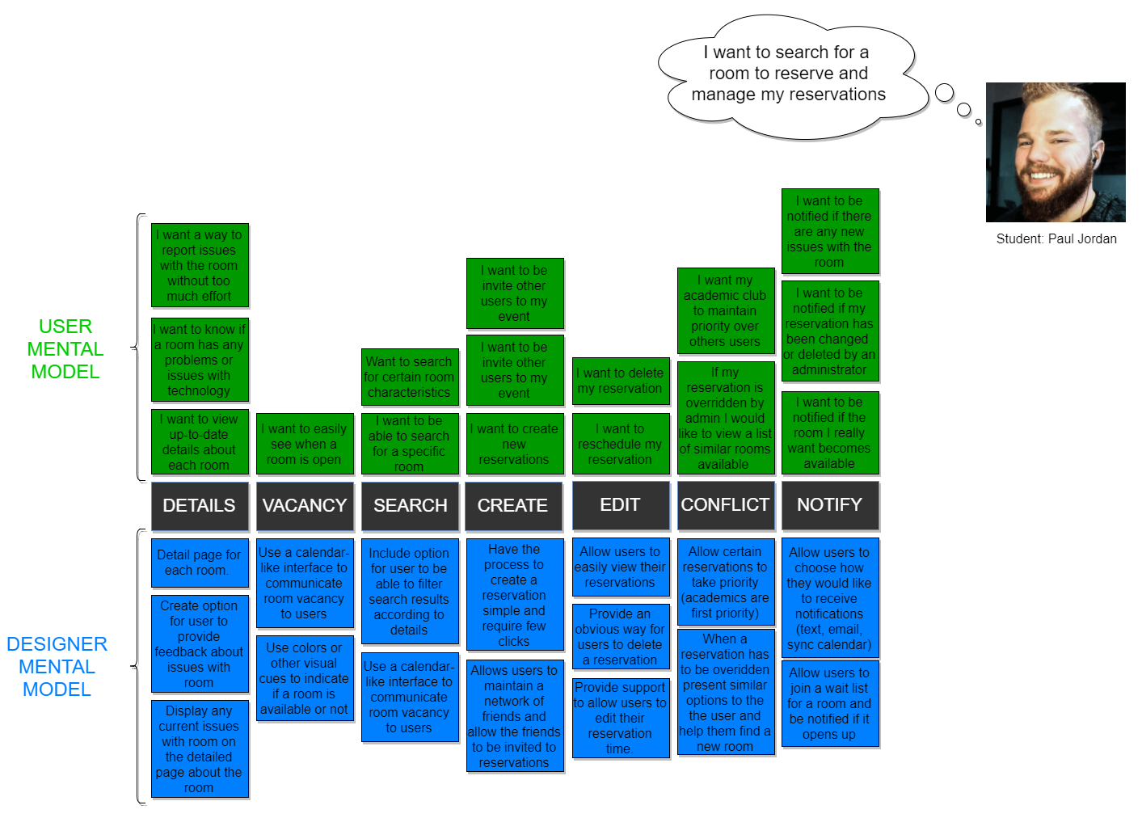
4: Design

Slide 25
5. Design & Prototype
For this process, we met together as a team and discussed what we felt would be relevant for this part in the process.
This required our team to look back at previous steps and make decisions for our prototype as a result.
Workflows & Whiteboard
System User
Building Manager
System Administrator
Notes:
For this process, we met together as a team and discussed what we felt would be relevant for this part in the process.
This required our team to look back at previous steps and make decisions for our prototype as a result.
Workflows & Whiteboard
System User
Building Manager
System Administrator

Slide 26
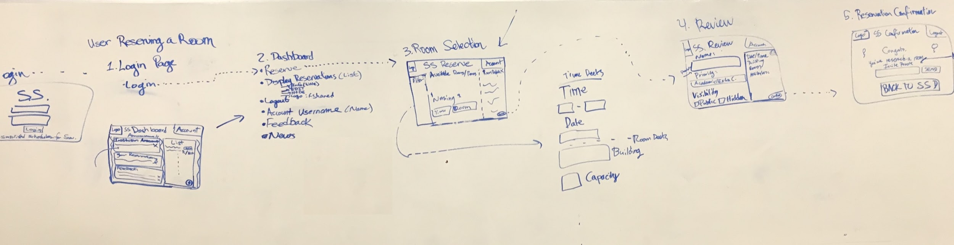
5. Design & Prototype
System User
Reserving a Room
Notes:
System User
Reserving a Room

Slide 27
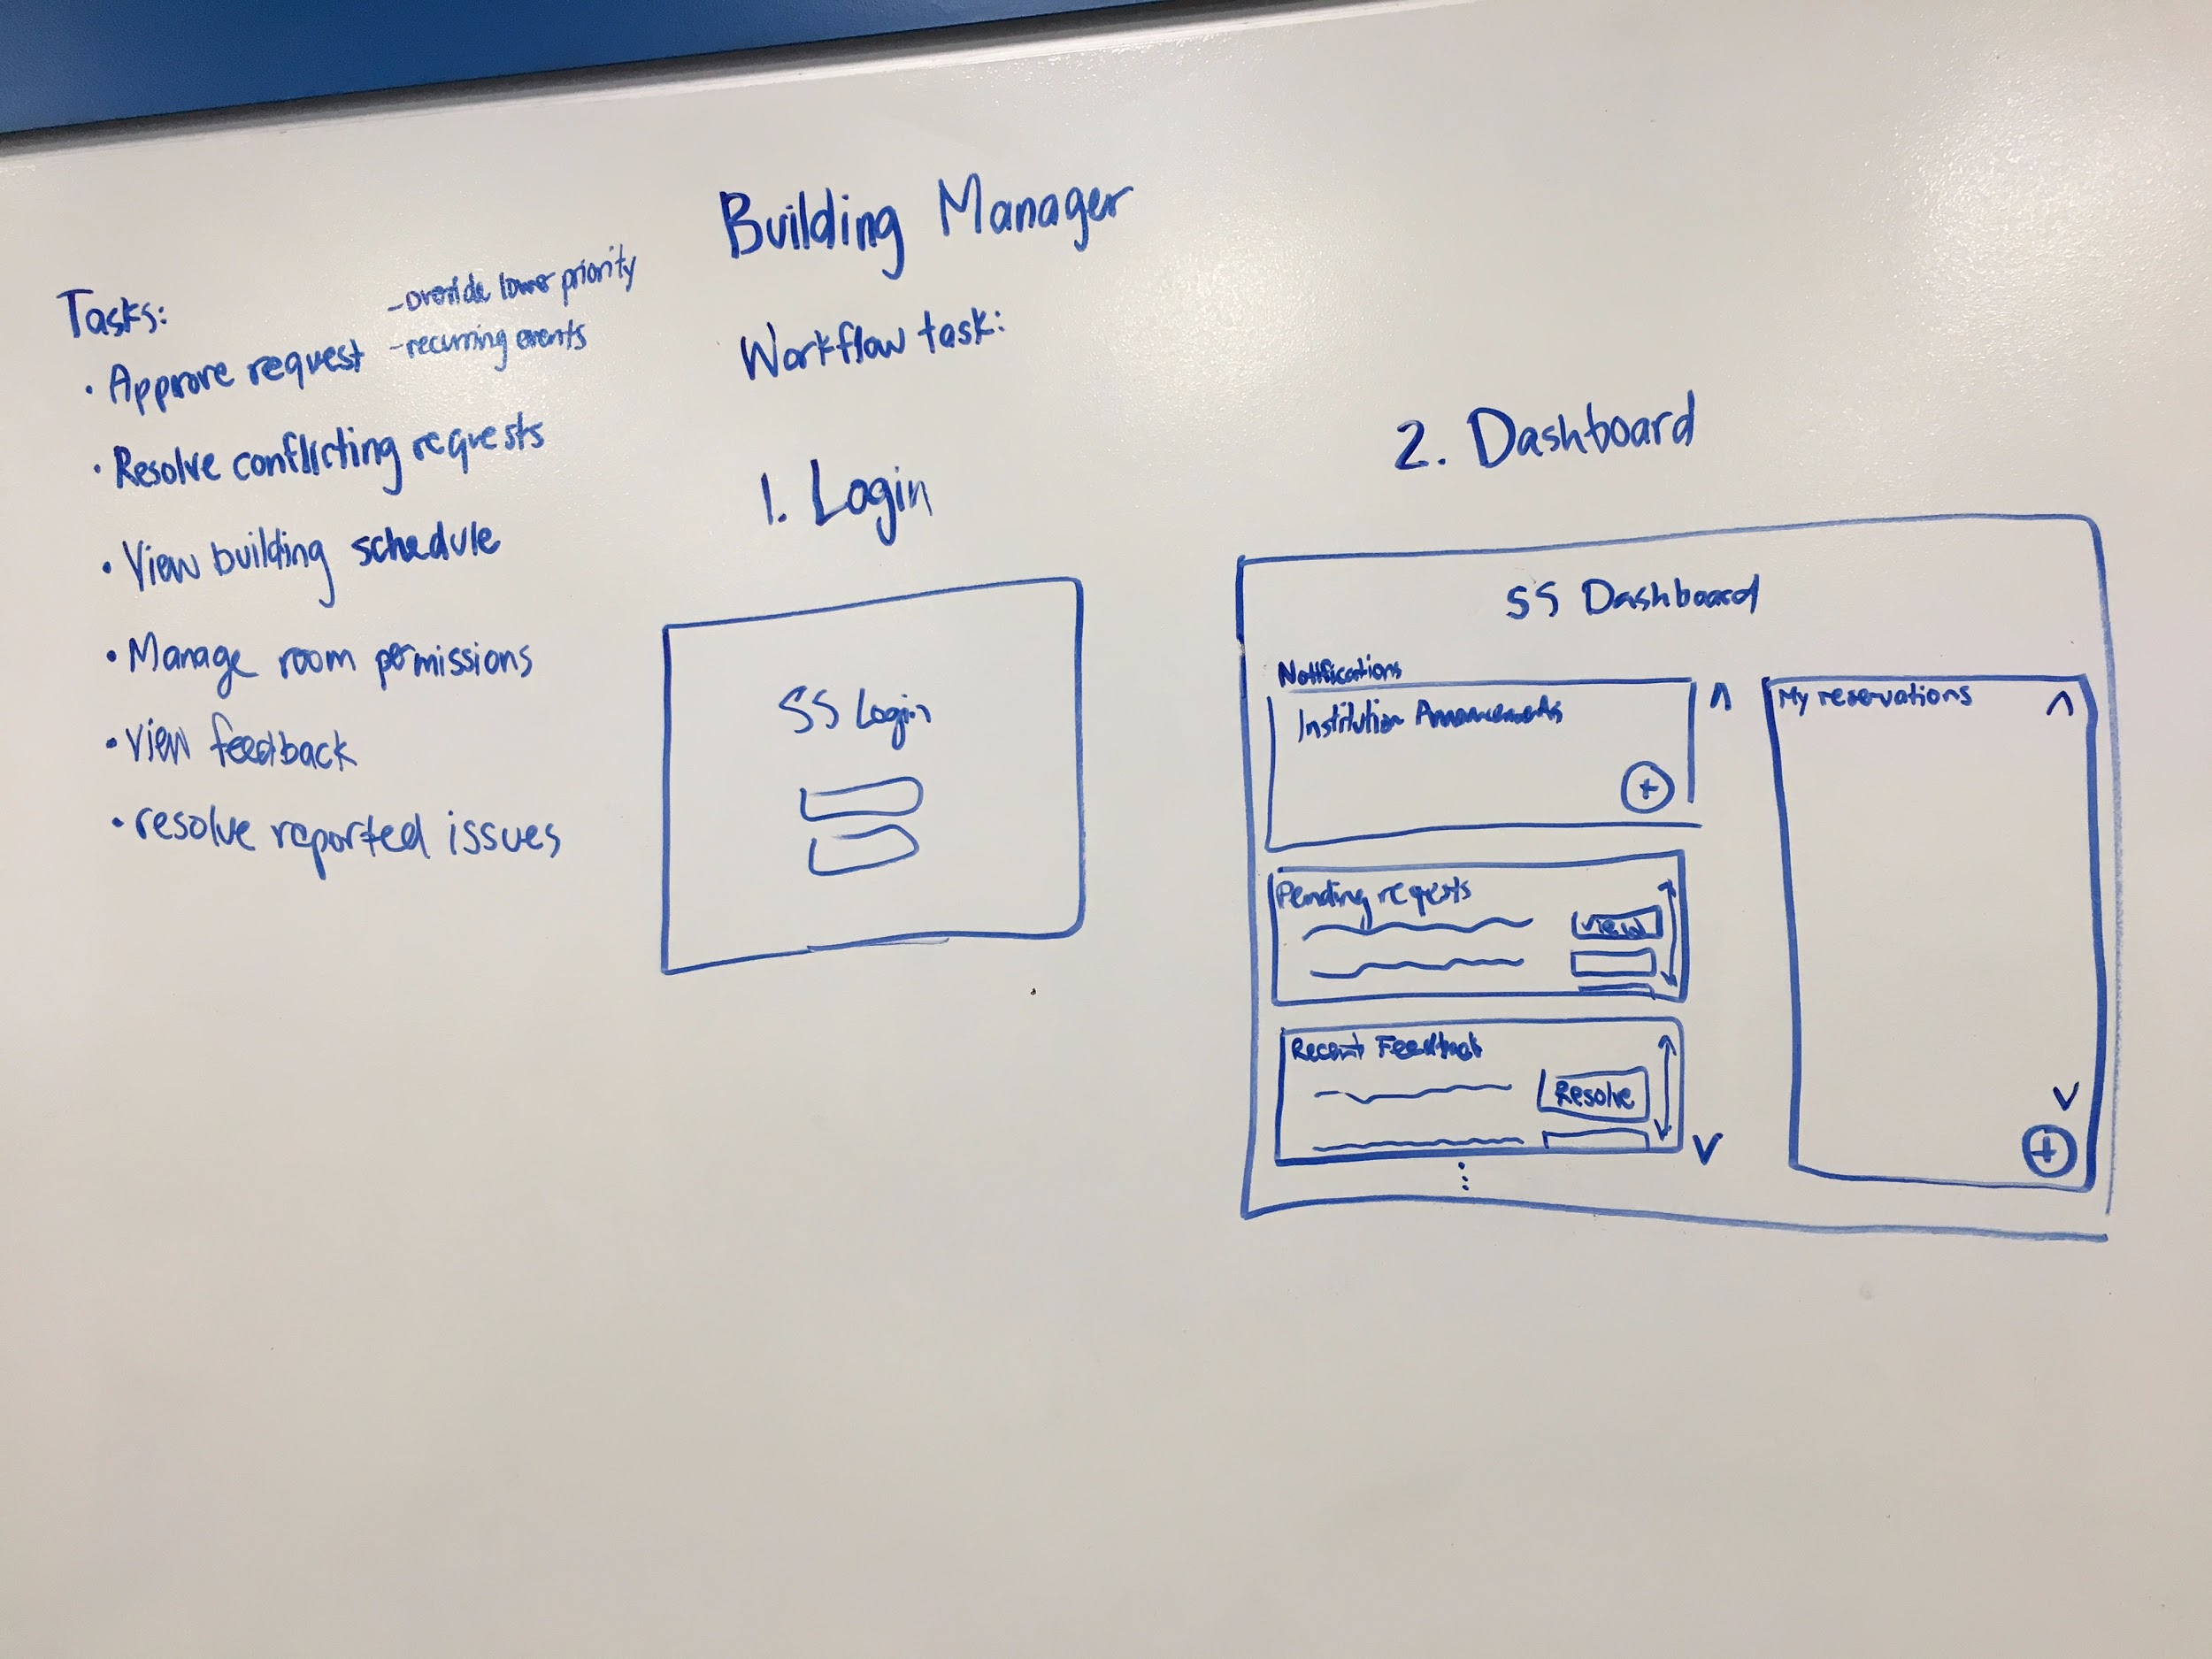
5. Design & Prototype
Building Manager
Resolve conflicting reservations & room feedback
Notes:
Building Manager
Resolve conflicting reservations & room feedback

Slide 28
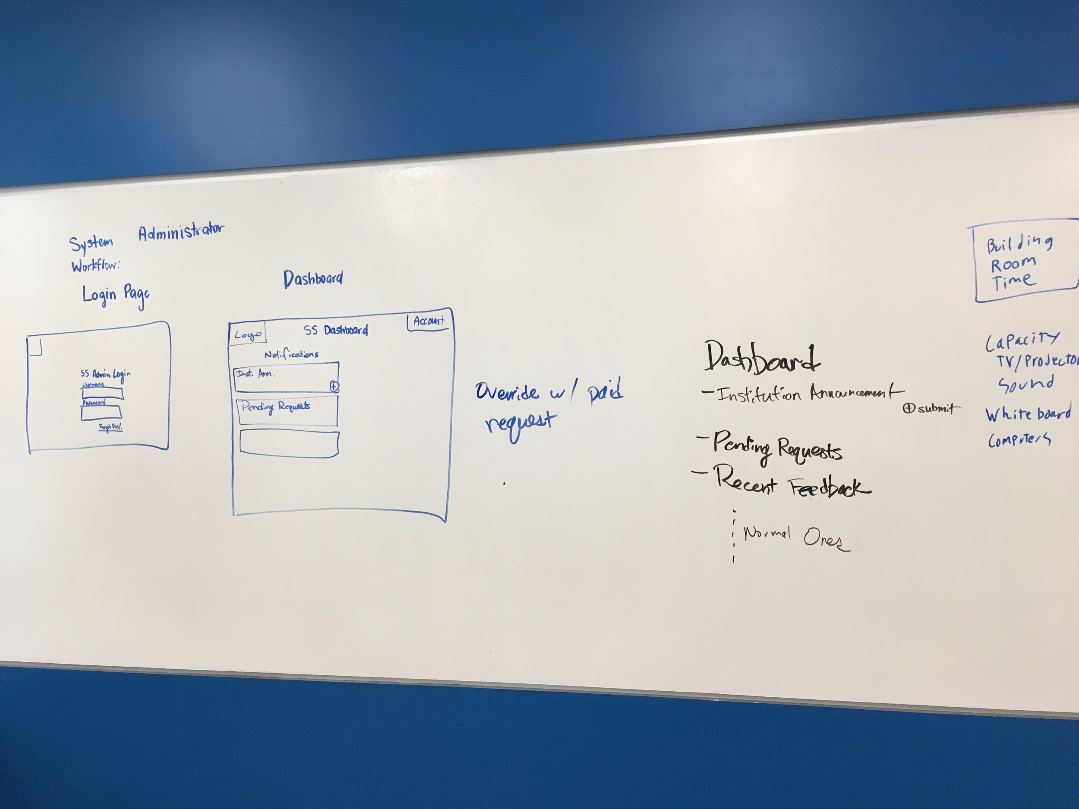
5. Design & Prototype
System Administrator
Create a Outside Business Reservation that overrides an existing reservation
Notes:
System Administrator
Create a Outside Business Reservation that overrides an existing reservation

Slide 29
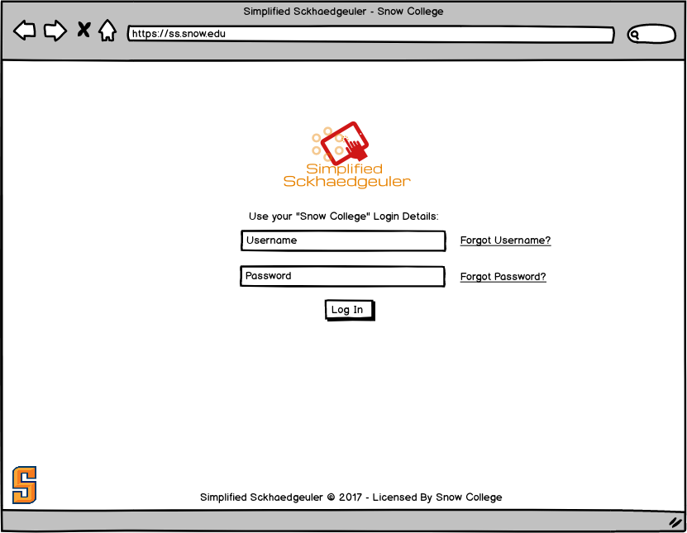
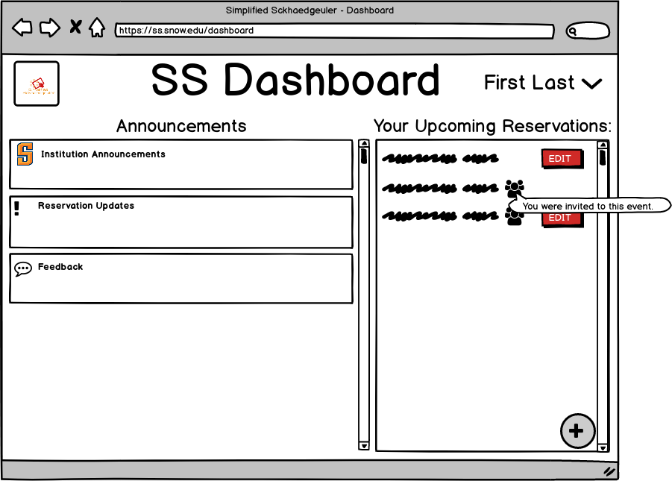
5. Design & Prototype
System User Prototype - Balsamiq
Notes:
System User Prototype - Balsamiq

Slide 30
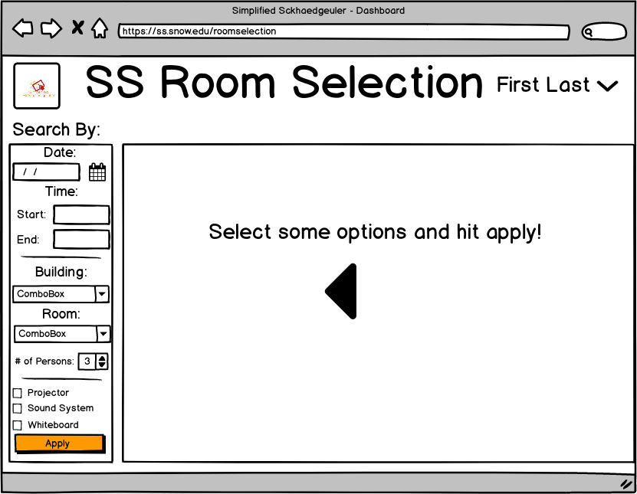
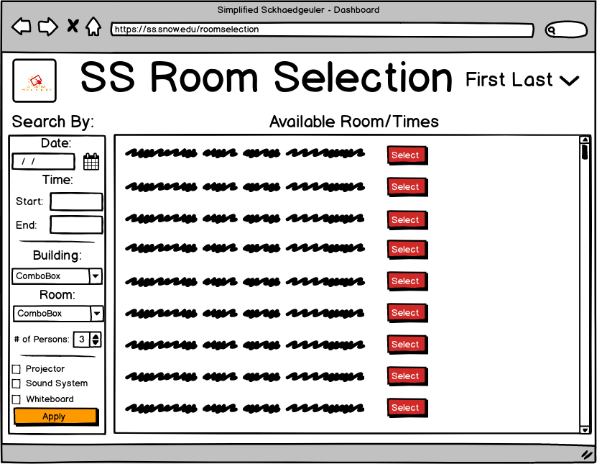
5. Design & Prototype
System User Prototype - Balsamiq
Notes:
System User Prototype - Balsamiq

Slide 31
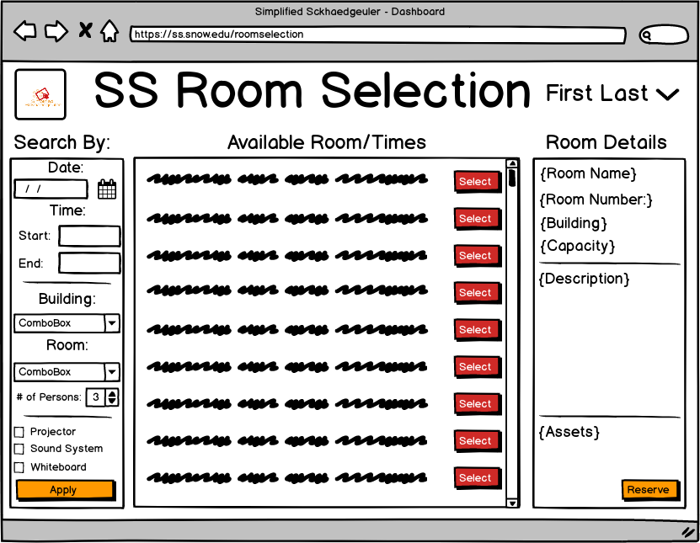
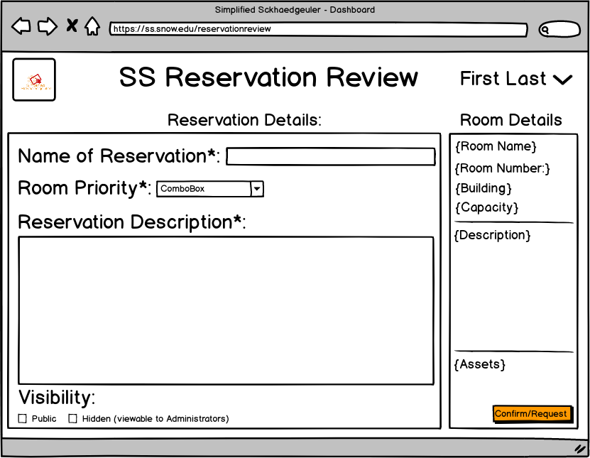
5. Design & Prototype
System User Prototype - Balsamiq

Slide 32
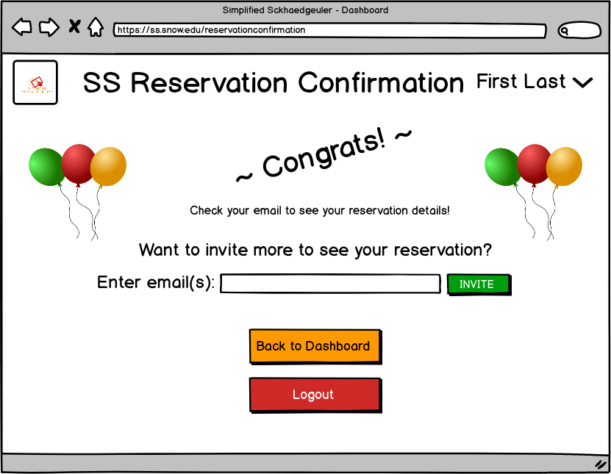
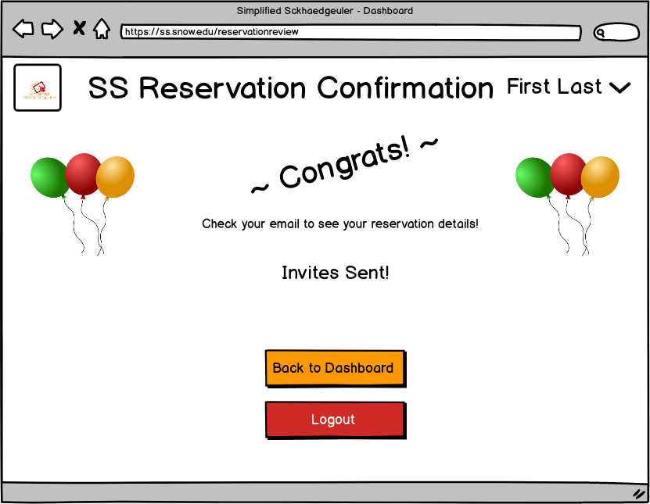
5. Design & Prototype
System User Prototype - Balsamiq
Notes:
System User Prototype - Balsamiq

Slide 33
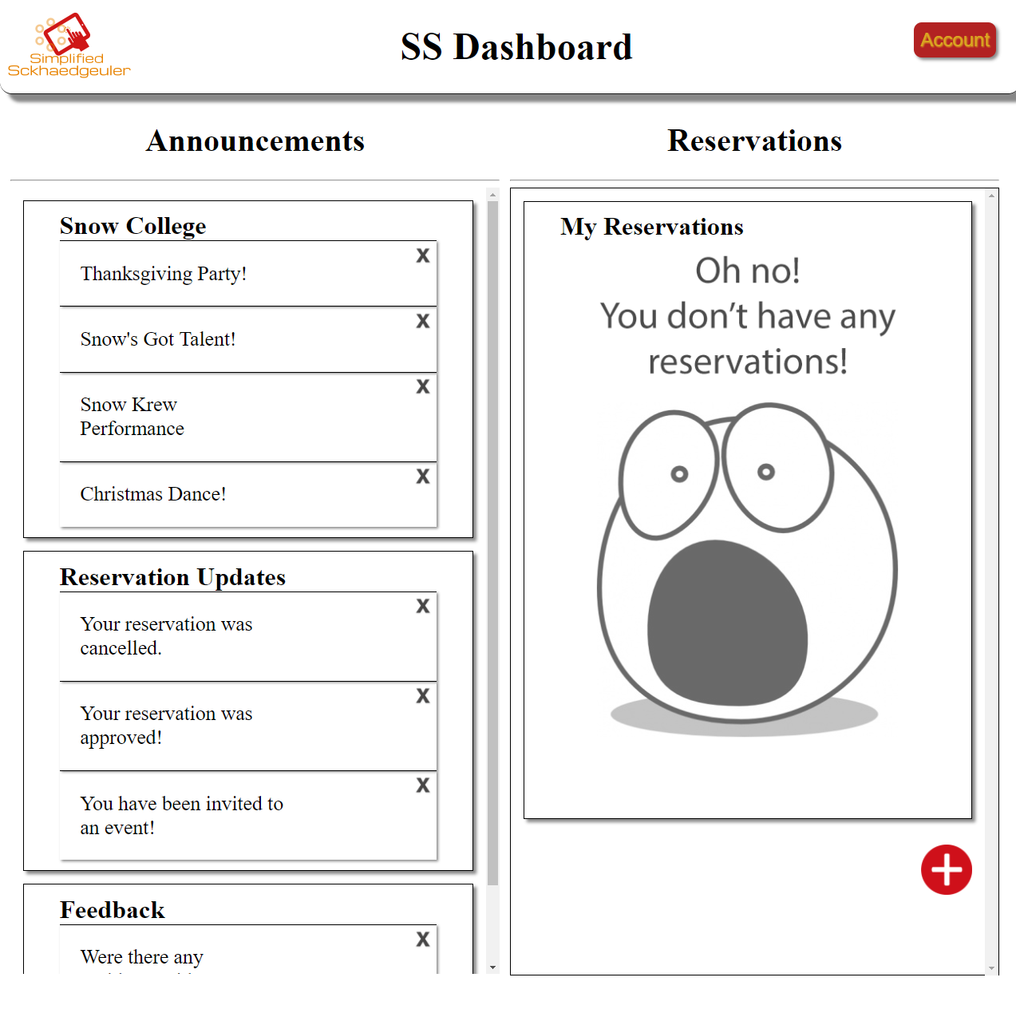
5. Design & Prototype
System User Prototype - Leedan’s Website
http://www.ljdemosites.x10host.com/SS/
Notes:
System User Prototype - Leedan’s Website
http://www.ljdemosites.x10host.com/SS/

Slide 34
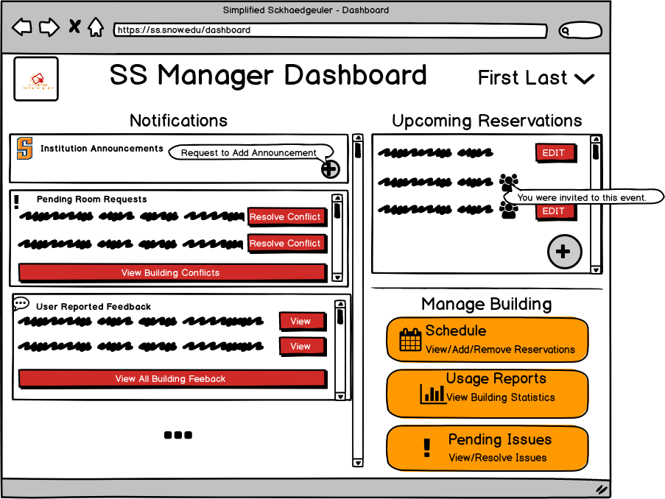
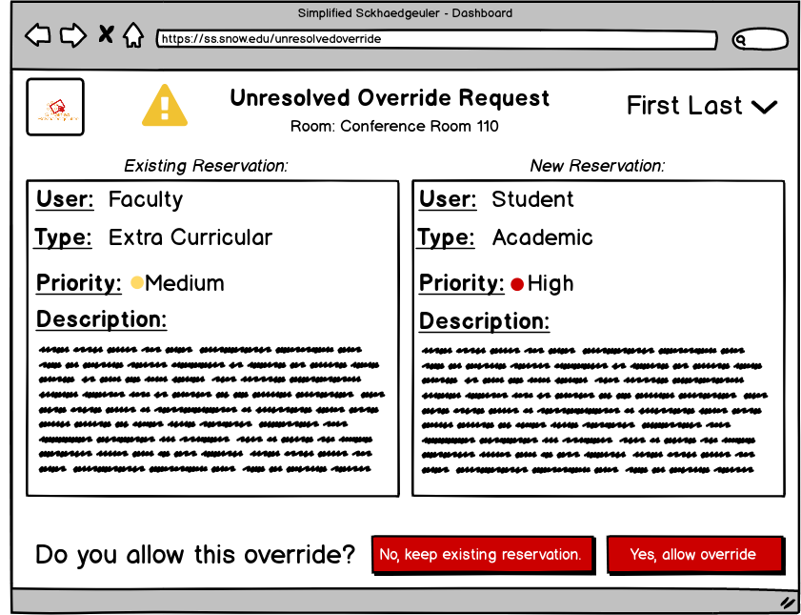
5. Design & Prototype
Building Manager Dashboard & Difference
Notes:
Building Manager Dashboard & Difference

Slide 35
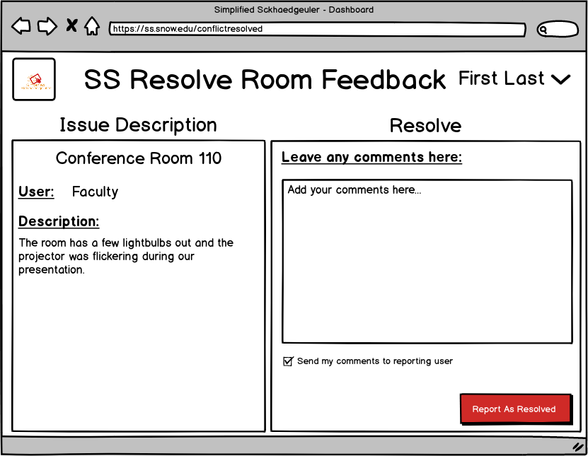
5. Design & Prototype
Building Manager Dashboard & Difference
Notes:
Building Manager Dashboard & Difference

Slide 36
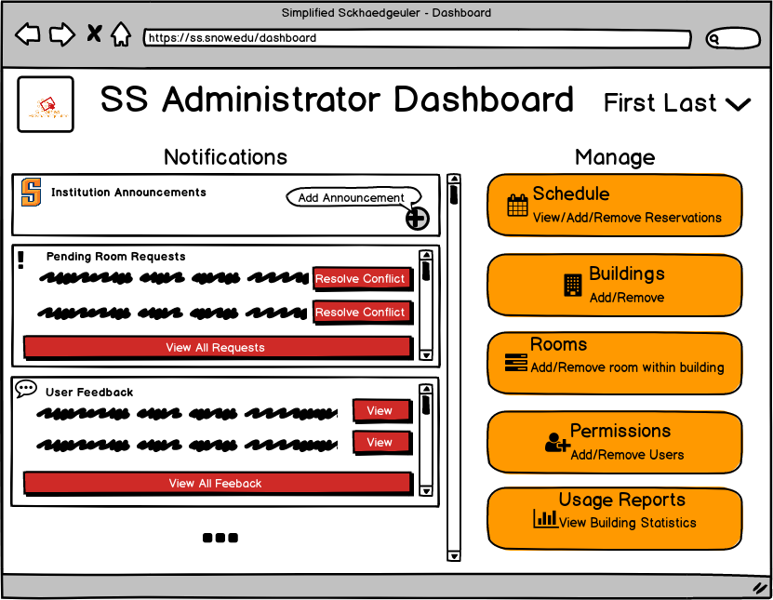
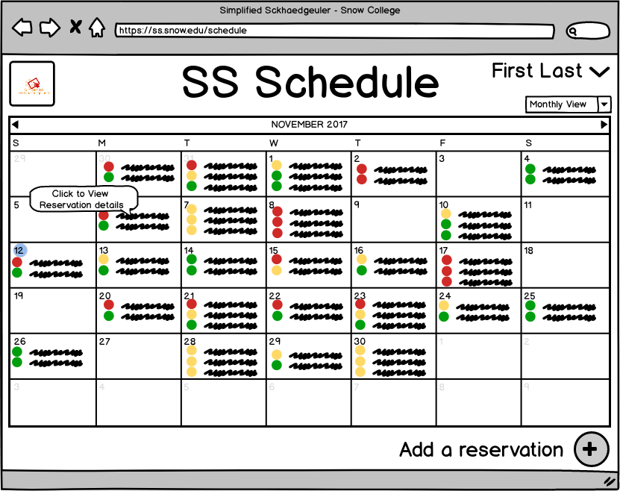
5. Design & Prototype
System Administrator Dashboard & Difference
Notes:
System Administrator Dashboard & Difference

Slide 37
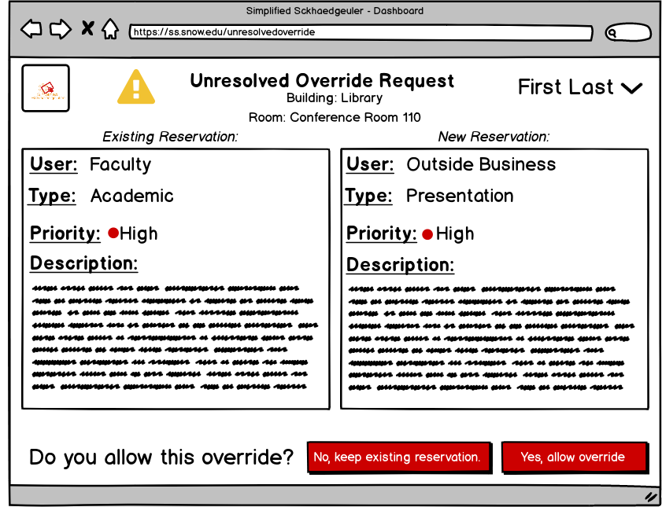
5. Design & Prototype
System Administrator Dashboard & Difference
Notes:
System Administrator Dashboard & Difference

Slide 38
5. Design & Prototype
Pilot Testing
Senario 1
System User - Create a Reservation
Senario 2
Option 1
Building Manager - Resolve Override
Option 2
Building Manager - Resolve Room/Reservation Feedback
Senario 3
System Administrator - Outside Business Reservation
Notes:
Pilot Testing
Senario 1
System User - Create a Reservation
Senario 2
Option 1
Building Manager - Resolve Override
Option 2
Building Manager - Resolve Room/Reservation Feedback
Senario 3
System Administrator - Outside Business Reservation

Slide 39
5. Design & Prototype
Pilot Testing Results
Senario 1
Confused on where to create new reservation
Invite Field - what is it?
Senario 2
Resolve Conflict Button - what does it do? Does that finalize the process?
Senario 3
We were missing key points in the wireframe prototype
Initial workflow was confusing
Notes:
Pilot Testing Results
Senario 1
Confused on where to create new reservation
Invite Field - what is it?
Senario 2
Resolve Conflict Button - what does it do? Does that finalize the process?
Senario 3
We were missing key points in the wireframe prototype
Initial workflow was confusing

Slide 40
6. UX Evaluation and Reporting
Our Inspection Process
Determining of usability of our prototype(s)
Script
Initial Questions
Tasks
Same Three Tasks as the Pilot Test (with the exception of resolving a room feeback)
Feedback During Evaluation
Camera
Audio
Screen Recording
Survey
Notes:
Our Inspection Process
Determining of usability of our prototype(s)
Script
Initial Questions
Tasks
Same Three Tasks as the Pilot Test (with the exception of resolving a room feeback)
Feedback During Evaluation
Camera
Audio
Screen Recording
Survey

Slide 41
6. UX Evaluation and Reporting
Script
“Hi, ___________. My name is ___________, and I’m going to be walking you through this session today. Before we begin, I have some information for you, and I’m going to read it to make sure that I cover everything. “
Questions:
First, what’s your occupation? What do you do all day?
Now, roughly how many hours a week altogether—just a ballpark estimate— would you say you spend using the Internet, including Web browsing and email, at work and at home?
And what’s the split between email and browsing—a rough percentage?
What kinds of sites are you looking at when you browse the Web?
Do you have any favorite Web sites?
OK, great. We’re done with the questions, and we can start looking at things.
Notes:
Script
“Hi, ___________. My name is ___________, and I’m going to be walking you through this session today. Before we begin, I have some information for you, and I’m going to read it to make sure that I cover everything. “
Questions:
First, what’s your occupation? What do you do all day?
Now, roughly how many hours a week altogether—just a ballpark estimate— would you say you spend using the Internet, including Web browsing and email, at work and at home?
And what’s the split between email and browsing—a rough percentage?
What kinds of sites are you looking at when you browse the Web?
Do you have any favorite Web sites?
OK, great. We’re done with the questions, and we can start looking at things.

Slide 42
6. UX Evaluation and Reporting
Our Tasks
Student Task
You are a Snow College student who was just assigned a group project. You are given the task of reserving a study room in the library. Your group wants to meet Nov 21 at 3:30 pm. There are 5 of you in the group, so you need to find a room with at least 5 chairs, they also want a TV or projector in the room. You will also need to send invites to your group mates.
Manager Task
You are a building manager for a college. Part of your responsibilities include handling requests students have submitted to override an existing reservation. Today we need you to resolve one of these conflicting requests. Academic meetings are given priority over extracurricular activities.
System Admin Task
You are the system administrator for a college. Part of your responsibilities include handling reservations by outside businesses. Today we need you to make a reservation for one of these outside businesses. The business has requested a room to seat at least 20 people, and has a projector. They will have their one hour meeting at 6:00 pm on December 4th. They are paying for the room, so they have priority over any existing reservations.
Notes:
Our Tasks
Student Task
You are a Snow College student who was just assigned a group project. You are given the task of reserving a study room in the library. Your group wants to meet Nov 21 at 3:30 pm. There are 5 of you in the group, so you need to find a room with at least 5 chairs, they also want a TV or projector in the room. You will also need to send invites to your group mates.
Manager Task
You are a building manager for a college. Part of your responsibilities include handling requests students have submitted to override an existing reservation. Today we need you to resolve one of these conflicting requests. Academic meetings are given priority over extracurricular activities.
System Admin Task
You are the system administrator for a college. Part of your responsibilities include handling reservations by outside businesses. Today we need you to make a reservation for one of these outside businesses. The business has requested a room to seat at least 20 people, and has a projector. They will have their one hour meeting at 6:00 pm on December 4th. They are paying for the room, so they have priority over any existing reservations.

Slide 43
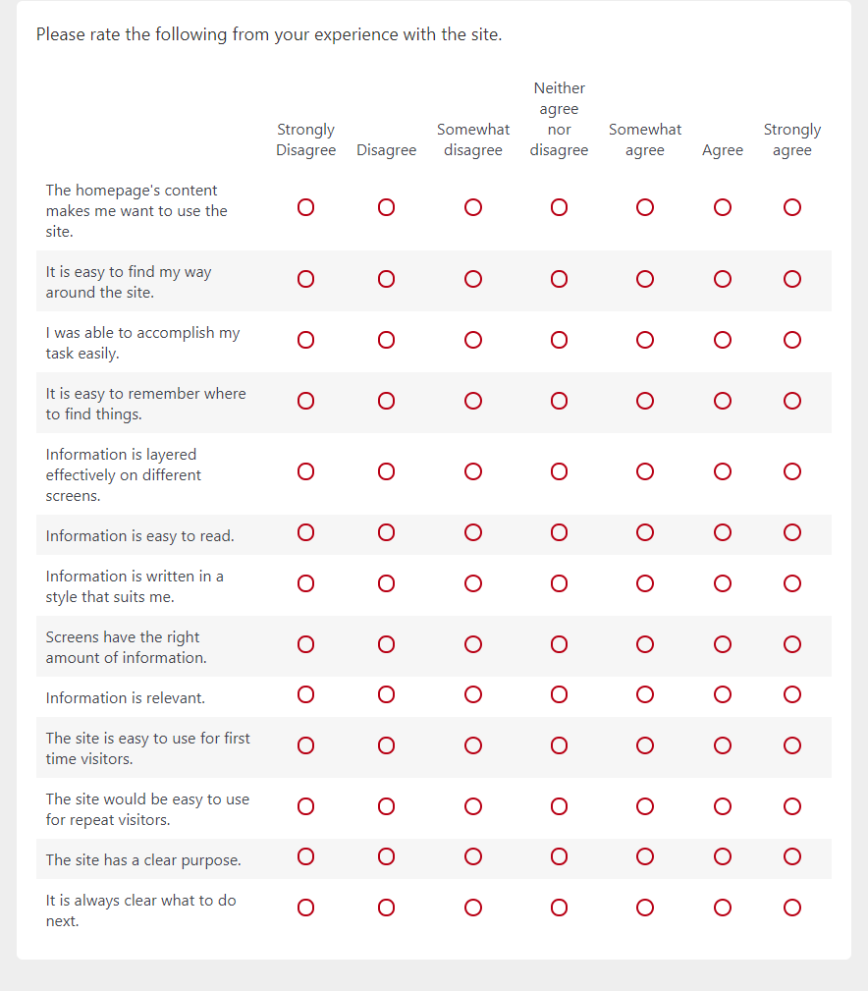
6. UX Evaluation and Reporting
Survey
Notes:
Survey

Slide 44
6. UX Evaluation and Reporting
Found UX Problems
Problem | Times Mentioned | Where Mentioned
ALLVIEWS: The software showed already reserved rooms by default! | 4 | MT 14:07, MT 14:44, MT 15:15, MT 16:19
ManagerView: Pending issues was misleading. Couldn't find room conflicts. | 7 | TB 11:47, TB 13:38, MT 9:00, MT 9:31, MT 10:50, NH2 0:20, NH4 0:15
AdminView: Expected to have a business-level priority | 2 | TB 16:15, MT 13:36
StudentView: Didn't really understand what/why "visibility" option | 3 | TB 8:28, MT 6:26, NH 4:04
Student View: Didn't understand priority | 2 | TB 7:52, MT 6:02
All Views: Why recursive link to homepage? | 1 | TB 5:50
AdminView: Expected an "any" option for building filter | 1 | TB 15:34
AdminView: User hesitate when presented with Invite Friends for business reservation | 2 | TB 16:47, NH3 0:38
Notes:
Found UX Problems

Slide 45
6. UX Evaluation and Reporting
Cost-Importance Analysis
COST-IMPORTANCE ANALYSIS
Problem | Importance | Solution | Cost (Hours) | Priority Ratio | Priority Rank | Cumulative Cost | Resolution?
ALLVIEWS: The software showed already reserved rooms by default! | M | Add an option on the room page to display available rooms and all rooms | 5 | M | 1 | 5 | Fix now
ManagerView: Pending issues was misleading. Couldn't find room conflicts. | 5 | Remove the pending issues button as it is redundant and only serves to confuse | 0.5 | 10000 | 2 | 5.5 | Fix now
Student View: Didn't understand priority | 3 | Add a quick description here about the different priority types. | 0.5 | 6000 | 3 | 6 | Fix now
Notes:
Cost-Importance Analysis

Slide 46
6. UX Evaluation and Reporting
Cost-Importance Analysis
Problem | Importance | Solution | Cost (Hours) | Priority Ratio | Priority Rank | Cumulative Cost | Resolution?
AllViews: Flow was a problem | 3 | Re-evaluate the flow using the evaluation feedback and expected path vs actual path data | 10 | 300 | 24 | 82.5 | fix, time permitting
AdminView: Dashboard was confusing | 1 | Redesign the admin dashboard according to evaluation data | 10 | 100 | 25 | 92.5 | Wait until next version
StudentView: User wanted social Media Integration | 1 | Add the abililty for users to import their social media contact | 10 | 100 | 26 | 102.5 | postpone indefinitely
StudentView: Can't the software make assumptions to speed things up? | 1 | Have the software remember certain user data to speed up the interaction | 10 | 100 | 27 | 112.5 | Fix on next version
Notes:
Cost-Importance Analysis

Slide 47
6. UX Evaluation and Reporting
Tailoring Our Scope (again)
Didn’t include anything outside our personas
3 tasks
Didn’t include business users
What Worked and What Didn’t
Camera
Screen Recording
Talking out loud
Notes:
Tailoring Our Scope (again)
Didn’t include anything outside our personas
3 tasks
Didn’t include business users
What Worked and What Didn’t
Camera
Screen Recording
Talking out loud

Slide 48
6. UX Evaluation and Reporting
What We Learned
Not all of our ideas are what the users want
Be willing to change ideas
Level of importance
Is what the user wants feasible?
Everyone uses our product differently
Need for iteration
Cost! We can’t do everything.
Each step in the process is crucial - you can’t skip ahead
Interviews are important - we need to stay on correct topic
Various models take time - make sure to take time to create them
Other thoughts
Notes:
What We Learned
Not all of our ideas are what the users want
Be willing to change ideas
Level of importance
Is what the user wants feasible?
Everyone uses our product differently
Need for iteration
Cost! We can’t do everything.
Each step in the process is crucial - you can’t skip ahead
Interviews are important - we need to stay on correct topic
Various models take time - make sure to take time to create them
Other thoughts

Slide 49
Questions?

